Slide 1


Cyberbullying and Fake Account Detection in Social Media
Vivekanand Education Society’s Institute Of Technology
Department Of Computer Engineering
Project Review 1
Group Members (Class,Roll no.)
Jayesh Samtani D17A - 57
Sagar Sidhwa D17A - 62
Somesh Tiwari D17A - 71
Riya Wadhwani D17A - 74
Mentor Details:
Name: Mr. Richard Joseph
Designation : Asst. Professor
Group Number : 48
Notes:
NOTE:
To change the image on this slide, select the picture and delete it. Then click the Pictures icon in the placeholder to insert your own image.

Slide 2
INDEX
Vivekanand Education Society’s Institute Of Technology
Department Of Computer Engineering

Slide 3
Index
Introduction
Problem definition
Block diagram
DFD Diagram
Algorithms implemented
UI screens
Results obtained
Plan of action for the upcoming month
Conclusion
References

Slide 4
INTRODUCTION
Vivekanand Education Society’s Institute Of Technology
Department Of Computer Engineering

Slide 5
Introduction
Cyber Crime and Bullying have increased on Social Networking sites with having more than 50 Crores active users until now, so the misuse of the Online Social Platform had taken place in several times for e.g Bullying Someone by sending the harmful messages ,spreading of the harassment messages by using the fake accounts, using the abusive words on the social media etc
In a recent report it was found that nearly 25% of People, especially teens and young adults are finding new ways to bully one another over the Internet and parents don’t know that their child has been involved in a cyberbullying incident.
A Preventive measure to STOP the above crimes caused a need for different Machine Learning algorithms for detection of the Cyber Crime and Bullying and the fake accounts so as to report these issues to the system immediately and to stop the crimes to increase in future and develop a secure online environment.

Slide 6
PROBLEM DEFINITION
Vivekanand Education Society’s Institute Of Technology
Department Of Computer Engineering

Slide 7
Problem Definition
Nowadays, cybercrime is one of the common issues everyone is facing and it is impacting the people, in which some are long period of sadness, anger, irritability, loss of interest in activities, being restless, anxious and worried, even in some cases they go into depression and take steps to scarify their life.It is unfortunate that there are no special Anti-Cyberbullying Laws in India yet.There are some common types of cyberbullying that is Flaming, Harassment, Denigration,Impersonation,Trickery. So to detect cyberbullying we have to make some software that will detect it and then report it to www.cybercrime.gov.in. Similarly, we will detect fake accounts.

Slide 8
BLOCK DIAGRAM
Vivekanand Education Society’s Institute Of Technology
Department Of Computer Engineering

Slide 9
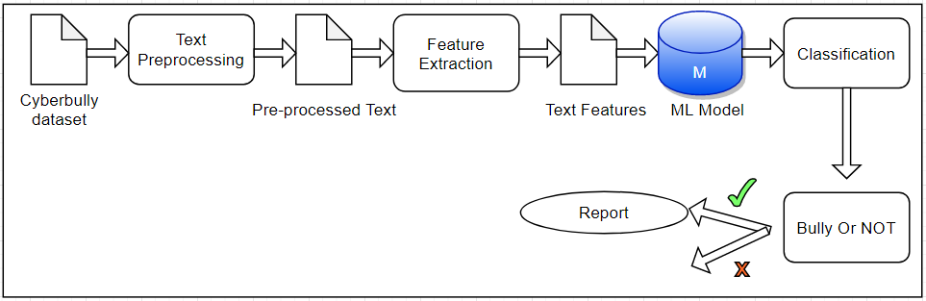
Block Diagram For Cyber Bullying

Slide 10
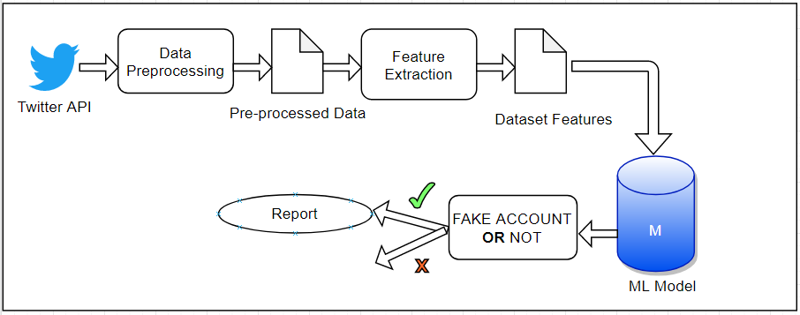
Block Diagram For Fake Account

Slide 11
DATA FLOW DIAGRAMS
Vivekanand Education Society’s Institute Of Technology
Department Of Computer Engineering

Slide 12
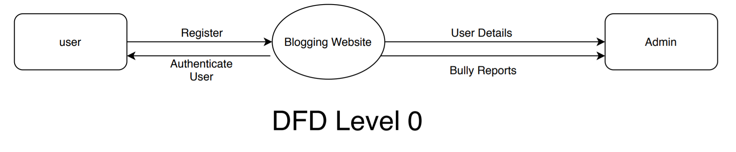
DFD Level 0

Slide 13
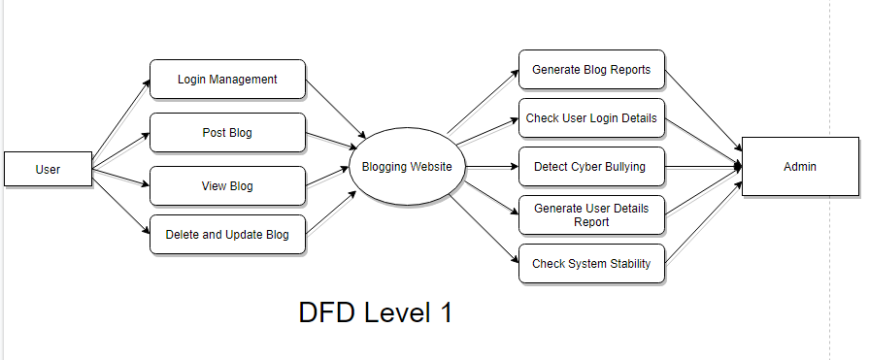
DFD Level 1

Slide 14
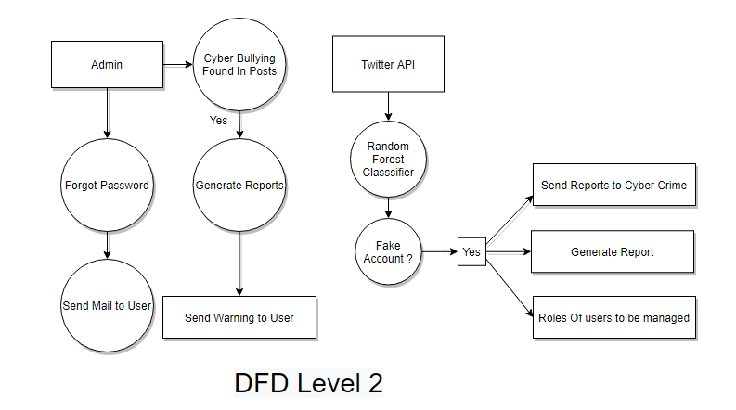
DFD Level 2

Slide 15
ALGORITHMS IMPLEMENTED
Vivekanand Education Society’s Institute Of Technology
Department Of Computer Engineering

Slide 16
Algorithms Implemented
1] Cyber Bullying
Stochastic Gradient Classifier
SGD Classifier is a linear classifier (SVM, logistic regression, a.o.) optimized by the SGD. These are two different concepts. While SGD is a optimization method, Logistic Regression or linear Support Vector Machine is a machine learning algorithm/model. You can think of that a machine learning model defines a loss function, and the optimization method minimizes/maximizes it.
The word ‘stochastic‘ means a system or a process that is linked with a random probability. Hence, in Stochastic Gradient Descent, a few samples are selected randomly instead of the whole data set for each iteration. In Gradient Descent, there is a term called “batch” which denotes the total number of samples from a dataset that is used for calculating the gradient for each iteration. In typical Gradient Descent optimization, like Batch Gradient Descent, the batch is taken to be the whole dataset. Although, using the whole dataset is really useful for getting to the minima in a less noisy and less random manner, but the problem arises when our datasets gets big.
So, in SGD, we find out the gradient of the cost function of a single example at each iteration instead of the sum of the gradient of the cost function of all the examples

Slide 17
Algorithms Implemented
LSTM
Long Short Term Memory is a kind of recurrent neural network. In RNN output from the last step is fed as input in the current step. LSTM was designed by Hochreiter & Schmidhuber. It tackled the problem of long-term dependencies of RNN in which the RNN cannot predict the word stored in the long term memory but can give more accurate predictions from the recent information. As the gap length increases RNN does not give efficient performance. LSTM can by default retain the information for long period of time. It is used for processing, predicting and classifying on the basis of time series data.
Forget Gate: The information that no longer useful in the cell state is removed with the forget gate. Two inputs x_t (input at the particular time) and h_t-1 (previous cell output) are fed to the gate and multiplied with weight matrices followed by the addition of bias. The resultant is passed through an activation function which gives a binary output. If for a particular cell state the output is 0, the piece of information is forgotten and for the output 1, the information is retained for the future use.
Input gate: Addition of useful information to the cell state is done by input gate. First, the information is regulated using the sigmoid function and filter the values to be remembered similar to the forget gate using inputs h_t-1 and x_t. Then, a vector is created using tanh function that gives output from -1 to +1, which contains all the possible values from h_t-1 and x_t. Atlast, the values of the vector and the regulated values are multiplied to obtain the useful information
Output gate: The task of extracting useful information from the current cell state to be presented as an output is done by output gate. First, a vector is generated by applying tanh function on the cell. Then, the information is regulated using the sigmoid function and filter the values to be remembered using inputs h_t-1 and x_t. Atlast, the values of the vector and the regulated values are multiplied to be sent as an output and input to the next cell.

Slide 18
ALGORITHM IMPLEMENTED
2] Fake Account
Random Forest
Random forest, like its name implies, consists of a large number of individual decision trees that operate as an ensemble. Each individual tree in the random forest spits out a class prediction and the class with the most votes becomes our model’s prediction
There are two stages in Random Forest algorithm, one is random forest creation, the other is to make a prediction from the random forest classifier created in the first stage. The whole process is shown below, and it’s easy to understand using the figure.
Here the author firstly shows the Random Forest creation pseudocode:
Randomly select “K” features from total “m” features where k << m
Among the “K” features, calculate the node “d” using the best split point
Split the node into daughter nodes using the best split
Repeat the a to c steps until “l” number of nodes has been reached
Build forest by repeating steps a to d for “n” number times to create “n” number of trees

Slide 19
UI SCREENS
Vivekanand Education Society’s Institute Of Technology
Department Of Computer Engineering

Slide 20
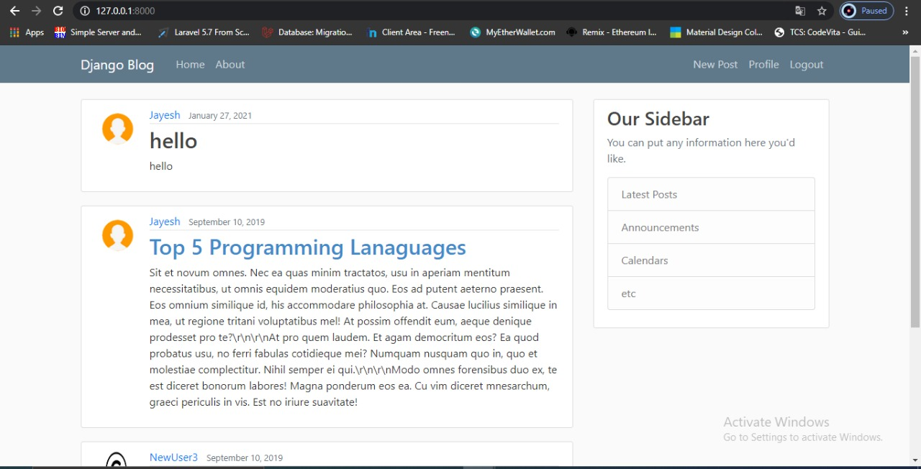
UI Screens
//Home Page

Slide 21
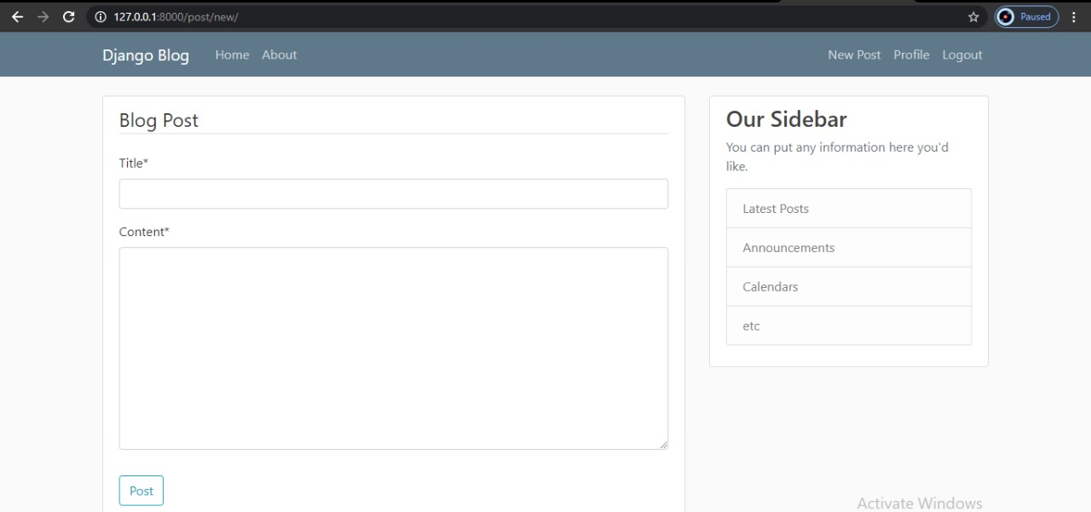
UI Screens
//Blog Post Page

Slide 22
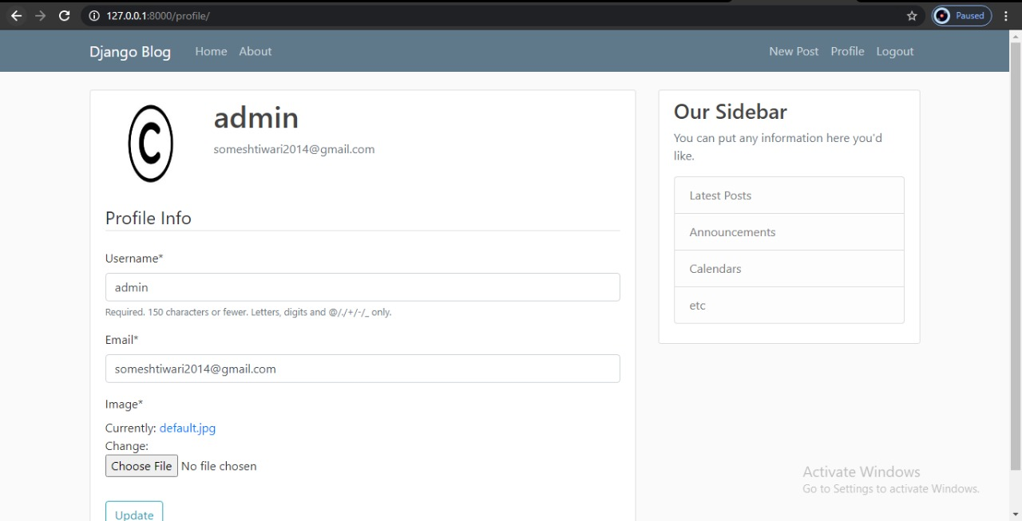
UI Screens
//Admin Page

Slide 23
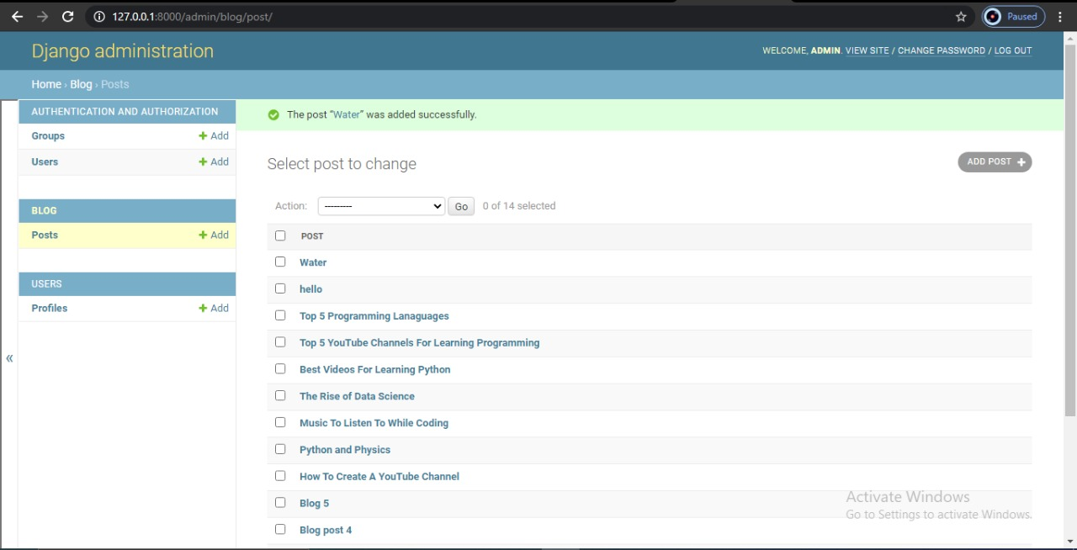
UI Screens
//Admin Blog-Post(Update,Delete) - Page

Slide 24
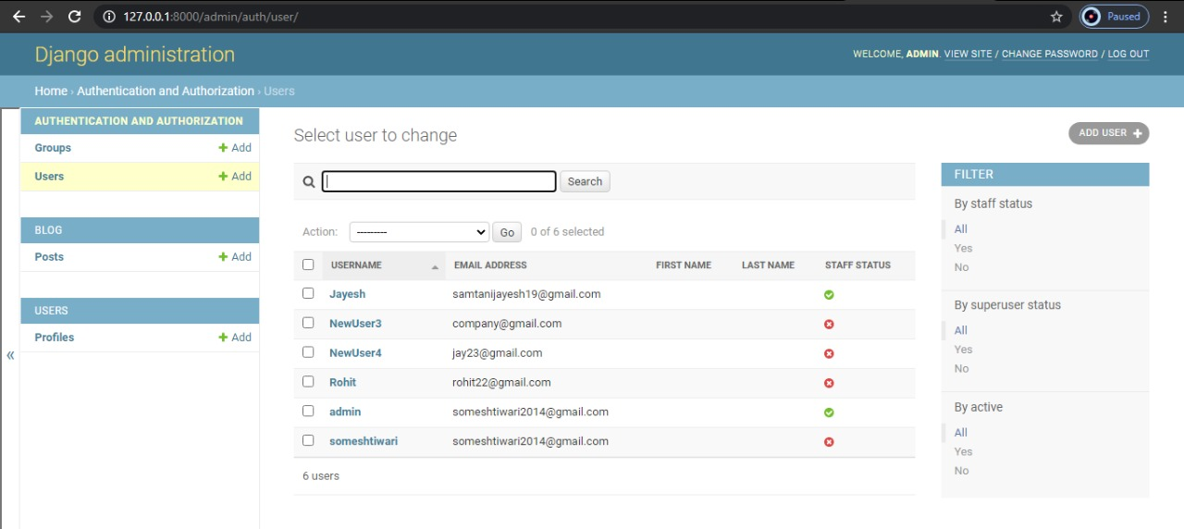
UI Screens
//Admin User(Add,Update,Delete) - Page

Slide 25
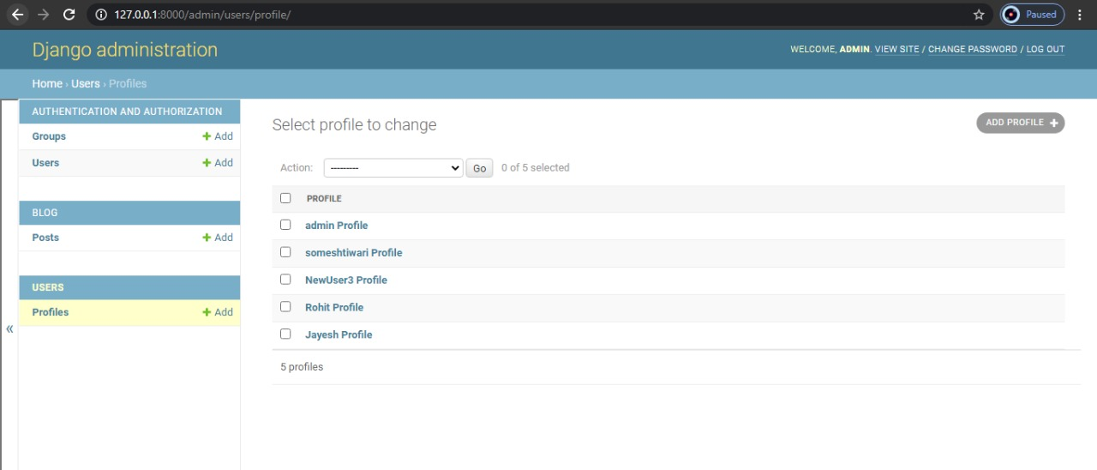
UI Screens
//Admin (Add,Update,Delete) - Page

Slide 26
RESULTS OBTAINED
Vivekanand Education Society’s Institute Of Technology
Department Of Computer Engineering

Slide 27
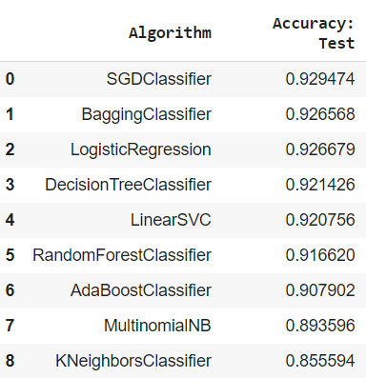
Results Obtained
Cyberbully Detection
We have trained and tested our cyberbully dataset on different models and found that the SGDClassifier gives the best result predicted that whether the blog posted contains the bully or not as compared to others as shown in fig.
Toxic Text Categorization
If the blog posted is founded bully by the SGDClassifier then whether the text is toxic, severe toxic, obscene, threat, insult, identity hate will be categorized by the NLP which is still under progress.
Cyberbully Detection

Slide 28
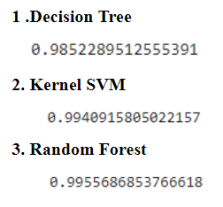
Results Obtained
Fake Account Detection
Fake Account Detection
We had trained and tested our models and found that Random Forest Algorithm will give the best results for fake account detection as compared to others as shown in fig.

Slide 29
PLAN OF ACTION FOR UPCOMING MONTHS
Vivekanand Education Society’s Institute Of Technology
Department Of Computer Engineering

Slide 30
Plan Of Action For Upcoming Months (if Any)
We had applied for the Twitter Api as soon as we will get it then we will directly test our live input data and will be ready with the fake account results.
Message or blog posted on blogging website and if found bully and passed to the NLP Model so that we can find whether the input is found as toxic, severe toxic, obscene, threat, insult, identity hate
To Integrate the Algorithms applied at the dataset with the blog website that we have created.

Slide 31
CONCLUSIONS
Vivekanand Education Society’s Institute Of Technology
Department Of Computer Engineering

Slide 32
Conclusion
In this project, we proposed an approach to detect Cyberbullying and Fake Account Detection using machine learning techniques.
We have evaluated our model on First Cyberbully and used Countvectorizer for features extraction and NLP for type of bully whether it is toxic, severe toxic, obscene, threat, insult, identity hate and for fake account detection we are using the twitter api to test the account is fake or not based on the different features.
We will eliminate the need for manual prediction of a fake account, which needs a lot of human resources and is also a time-consuming process.

Slide 33
REFERENCES
Vivekanand Education Society’s Institute Of Technology
Department Of Computer Engineering

Slide 34
References
S. Gurajala, J. S. White, B. Hudson, and J. N. Matthews, “Fake Twitter accounts: Profile characteristics obtained using an activity-based pattern detection approach,” in Proceedings of the 2015 International Conference on Social Media & Society , Toronto, Ontario, Canada, 2015.View at: Publisher Site | Google Scholar.
N. V. Chawla, K. W. Bowyer, L. O. Hall, and W. P. Kegelmeyer, “SMOTE: synthetic minority over-sampling technique,” Journal of Artificial Intelligence Research, vol. 16, pp. 321–357, 2002.View at: Google Scholar
I. Jolliffe, Principal Component Analysis, 2002.View at: MathSciNet.
S. Sperandei, “Understanding logistic regression analysis,” Biochemia Medica, vol. 24, no. 1, pp. 12–18, 2014.View at: Publisher Site | Google Scholar..

Slide 35
THANK YOU
Vivekanand Education Society’s Institute Of Technology
Department Of Computer Engineering

